Slide 1

Indexing techniques including B-tree, B+ tree and hashing
Database Management System | Storage Structures, Indexing and Query Optimization
Course: Database Management System | Chapter: Storage Structures, Indexing and Query Optimization | Program: B.TECH-CSE, B.TECH CSE - CYBER SECURITY, B.TECH CSE - DATA
DISCOVER · LEARN · EMPOWER
Notes:
Welcome everyone to today's lecture on indexing techniques. We will focus specifically on B-trees, B+ trees, and hashing within the context of storage structures. These are the fundamental mechanisms that allow databases to retrieve data efficiently. Remember, without these structures, searching through millions of records would be painfully slow.

Slide 2
Course Outcomes
SLIDE 2 / 14
Course Outcome
CO | BT LEVEL | DESCRIPTION
CO1 | BT2 | Explain database architecture, relational model concepts and formal query language foundations including relational algebra and relational calculus.
CO2 | BT3 | Apply relational algebra, relational calculus and SQL constructs to formulate correct and efficient database queries.
CO3 | BT4 | Analyze functional dependencies and design normalized relational schemas up to 5NF ensuring lossless join and dependency preservation.
CO4 | BT4 | Analyze transaction schedules and concurrency control mechanisms to determine serializability, recoverability and correctness.
CO5 | BT5 | Evaluate storage structures, indexing strategies and query optimization techniques for performance, scalability and reliability.
Chandigarh University
2 / 14
Notes:
Today's lecture directly addresses two specific course outcomes. First, we explain the foundations of database architecture through the lens of indexing. Second, we evaluate how B-trees and hashing strategies impact performance and reliability in real-world systems. Understanding these links is crucial for your engineering practice.

Slide 3
Learning Objectives
SLIDE 3 / 14
Learning Outcomes
1
Define the fundamental purpose of indexing in database storage structures.
2
Describe the structural differences between B-tree and B+ tree nodes.
3
Explain the role of leaf nodes in B+ tree sequential access.
4
Analyze how hashing techniques provide constant time data retrieval.
5
Compare the trade-offs between B+ trees and hashing for queries.
Chandigarh University
3 / 14
Notes:
By the end of this session, you will be able to define why indexing is necessary for large datasets. You will describe how B-trees differ from B+ trees, specifically regarding leaf nodes. We will also analyze hashing techniques and compare their trade-offs against tree-based structures for different query types.

Slide 4
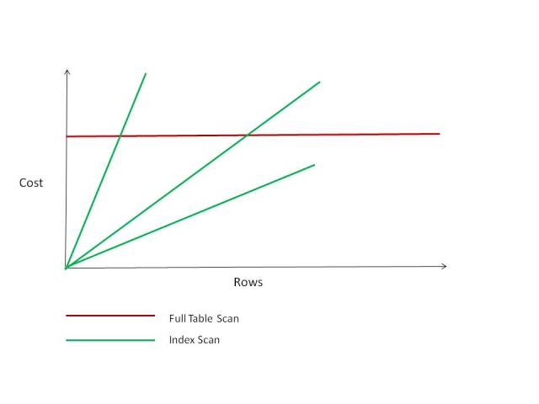
Lecture
SLIDE 4 / 14
Purpose of Indexing in Storage
1
Indexing acts as a lookup table to avoid full table scans.
2
It reduces disk I/O operations by locating data blocks directly.
3
Without indexing, search complexity is O(n) for linear scans.
4
With indexing, search complexity drops to O(log n) or O(1).
5
Indexes consume additional storage space proportional to the table size.
6
Maintenance overhead increases during frequent insert, update, and delete operations.
7
Primary indexes are built on primary keys to ensure uniqueness.
Indexes vs. Full Table Scan: Picture vs. 1000 Words (Pictures Of Lily) | Richard Foote's Oracle Blog
Chandigarh University
4 / 14
Notes:
Think of an index like the index at the back of a textbook. Without it, you must read every page to find a topic. With it, you jump directly to the page number. This reduces the search time from O(n) to O(log n). However, remember that every index consumes disk space and slows down write operations slightly.

Slide 5
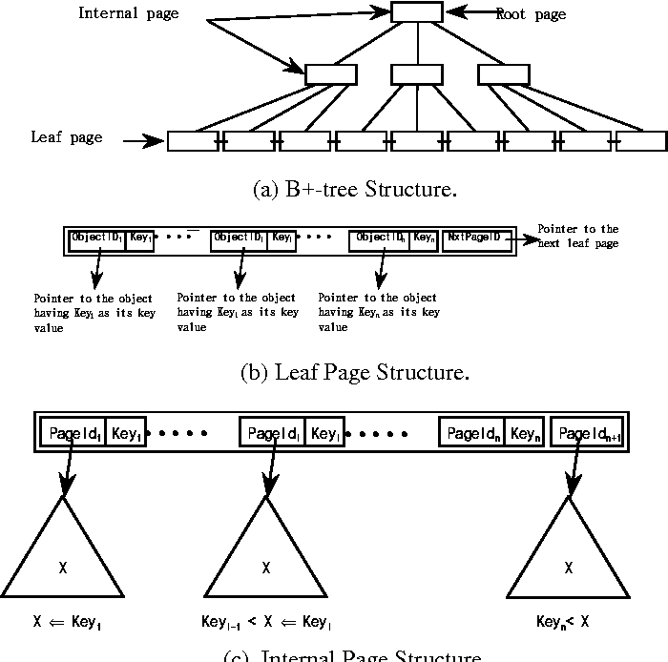
Lecture
SLIDE 5 / 14
B-tree Structure and Properties
1
B-trees are self-balancing search trees maintaining sorted data.
2
All leaf nodes appear at the same depth level in the tree.
3
Internal nodes store keys and pointers to child nodes simultaneously.
4
Each node can hold multiple keys and multiple child pointers.
5
The tree height remains logarithmic relative to the number of records.
6
Root node is the only node without a parent pointer.
7
Search, insertion, and deletion operations all take O(log n) time.
Source: miro.medium.com
Chandigarh University
5 / 14
Notes:
A B-tree is a self-balancing tree where all leaf nodes are at the same level. Unlike binary trees, internal nodes can hold multiple keys, which reduces the tree height significantly. This structure ensures that search, insertion, and deletion operations remain efficient at O(log n) regardless of data size.

Slide 6
Lecture
SLIDE 6 / 14
B+ tree vs B-tree Differences
1
B+ trees store all data pointers only in the leaf nodes.
2
Internal nodes in B+ trees contain only keys for navigation.
3
Leaf nodes in B+ trees are linked sequentially via pointers.
4
This linkage allows efficient range queries and sequential access.
5
B+ trees typically store more keys per node than B-trees.
6
Search performance is consistent for both point and range queries.
7
B+ trees are the standard choice for most database management systems.
Chandigarh University
6 / 14
Notes:
The key difference is where data resides. In a B-tree, data can be in internal nodes, but in a B+ tree, all data pointers are strictly in the leaf nodes. Furthermore, B+ tree leaf nodes are linked together, forming a linked list. This makes range queries, like finding all students between ages 20 and 25, extremely fast.

Slide 7
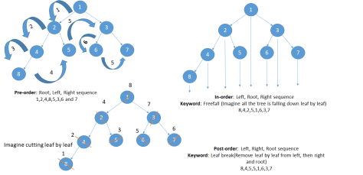
Worked Example
SLIDE 7 / 14
B+ Tree Search
GOVERNING EQUATION
Formula for height h = log_m(n)
m is order and n is records.
1
Consider a B+ tree with order 3 and keys: 10, 20, 30, 40.
2
Root node contains key 20 with left child 20.
3
To find key 30, compare 30 with root key 20.
4
Since 30 > 20, traverse to the right child node.
5
Right child contains keys 30 and 40; locate 30 directly.
6
Total disk accesses required for this search is exactly 2.
Source: sivakumarkumaravelu.wordpress.com
Chandigarh University
7 / 14
Notes:
Let's walk through a search for key 30. We start at the root with key 20. Since 30 is greater than 20, we move to the right child. This child contains 30 and 40. We find our target immediately. This entire process required only two disk accesses, demonstrating the efficiency of the logarithmic height.

Slide 8
Lecture
SLIDE 8 / 14
Hashing Techniques Overview
1
Hashing maps search keys directly to bucket addresses using a function.
2
The hash function h(k) computes the address for key k.
3
Ideal hashing provides O(1) constant time for exact match lookups.
4
Collision occurs when two different keys map to the same bucket.
5
Open addressing resolves collisions by probing for the next free slot.
6
Chaining resolves collisions by storing a linked list at each bucket.
7
Hashing is optimal for equality queries but poor for range queries.
Chandigarh University
8 / 14
Notes:
Hashing uses a function to calculate the exact address of a record. If you search for a specific ID, it is instant, O(1). However, if you need to find all records between two values, hashing fails because the data is not sorted. Collisions are inevitable, so we use chaining or open addressing to handle them.

Slide 9
Hashing
SLIDE 9 / 14
Chaining vs Open Addressing
1
Chaining stores a linked list of records at each hash bucket.
2
Overflow records are appended to the list at the collision site.
3
Performance degrades if the chain length becomes excessively long.
4
Open addressing stores all records directly in the hash table array.
5
Probing sequences like linear or quadratic search find empty slots.
6
Clustering occurs in open addressing, reducing search efficiency over time.
7
Chaining is generally preferred for databases with variable record sizes.
Chandigarh University
9 / 14
Notes:
In chaining, if two keys collide, we simply add a new node to the list at that bucket. In open addressing, we search for the next empty slot using a probe sequence. Chaining is often better for databases because it handles variable record sizes easily. However, if chains get too long, performance drops significantly.

Slide 10
Worked Example
SLIDE 10 / 14
Hash Function Calculation
GOVERNING EQUATION
Use the modulo hash function: h(k) = k mod m
1
Let table size m = 10 and search for key k = 123.
2
Calculate 123 mod 10 which equals 3.
3
The record for key 123 is stored at bucket index 3.
4
If key 133 is inserted, 133 mod 10 also equals 3.
5
This creates a collision requiring chaining or probing resolution.
6
Average search time is 1 + α/2 where α is load factor.
Chandigarh University
10 / 14
Notes:
Let's calculate the address for key 123 using a modulo function with table size 10. 123 divided by 10 leaves a remainder of 3. So, the record goes to bucket 3. If we insert 133, it also lands in bucket 3. This collision means we must use chaining to store both records in that bucket.

Slide 11
Lecture
SLIDE 11 / 14
Common Pitfalls in Indexing
1
Creating too many indexes slows down write operations significantly.
2
Ignoring selectivity leads to indexes that are never used by the optimizer.
3
Using non-selective columns like gender for indexing yields poor results.
4
Fragmentation occurs over time, reducing the efficiency of B+ trees.
5
Incorrect data types in index columns prevent efficient range scans.
6
Over-indexing increases storage costs and maintenance overhead unnecessarily.
7
Failing to update statistics causes the query optimizer to choose wrong paths.
Chandigarh University
11 / 14
Notes:
A common mistake is creating too many indexes. While this speeds up reads, it drastically slows down inserts and updates. Another pitfall is indexing low-selectivity columns, like gender, which provides little filtering power. Always ensure your indexes are selective and that the database statistics are up to date.

Slide 12
Performance Comparison
SLIDE 12 / 14
B+ Tree vs Hashing
1
B+ trees support both equality and range queries efficiently.
2
Hashing supports only equality queries with O(1) average time.
3
B+ trees require O(log n) time for range scans.
4
Hashing requires a full table scan for range queries.
5
B+ trees handle sorting and ordering naturally without extra cost.
6
Hashing requires re-sorting data for any ordered output requirement.
7
B+ trees are preferred for general-purpose database workloads.
Chandigarh University
12 / 14
Notes:
If you need to find a specific ID, hashing is faster. But if you need to find all records in a range, B+ trees are superior. Hashing cannot handle range queries efficiently because the data is not ordered. Therefore, B+ trees are the standard for general-purpose databases where both types of queries are common.

Slide 13
Lecture
SLIDE 13 / 14
Key Takeaways
1
Indexing transforms O(n) searches into O(log n) or O(1) operations.
2
B+ trees are ideal for range queries due to linked leaf nodes.
3
Hashing offers instant lookups but fails for range and sorting queries.
4
Collisions in hashing must be managed via chaining or open addressing.
5
Excessive indexing degrades write performance and increases storage costs.
Chandigarh University
13 / 14
Notes:
To summarize, indexing is essential for performance, reducing search × dramatically. B+ trees are the most versatile structure, handling both point and range queries. Hashing is fast for exact matches but limited. Finally, remember that more indexes are not always better; they come with a cost to write performance.

Slide 14
Lecture
SLIDE 14 / 14
References
1
Fundamentals of Database Systems — Ramez Elmasri & Shamkant B. Navathe
2
Database System Concepts — Silberschatz, Korth & Sudarshan
3
Database Management Systems — Raghu Ramakrishnan & Johannes Gehrke
4
Oracle/MySQL Documentation — Oracle
Chandigarh University
14 / 14
Notes:
These are the standard reference texts for this course. Elmasri and Navathe provide a deep theoretical foundation. Silberschatz offers excellent practical examples. Ramakrishnan covers optimization techniques in detail. Finally, the Oracle and MySQL documentation provides specific implementation details for these indexing structures.

